Slide 1
all ABOUT ME
Maria Gómez ♥

Slide 2
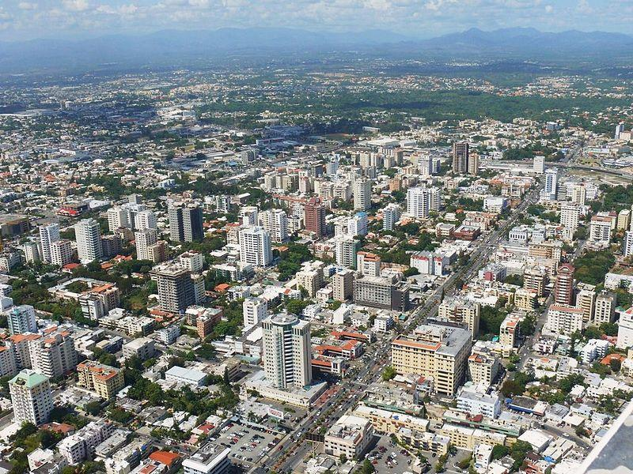
Where are you from?
I from Dominican Republic , Santo Domingo.

Slide 3
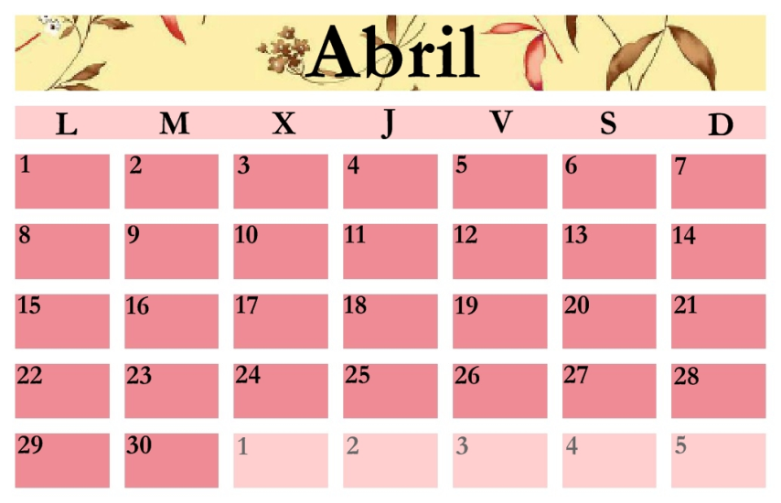
when is your birthday
My birthday is in April 21

Slide 4
How old are you?
I am 14 years old

Slide 5
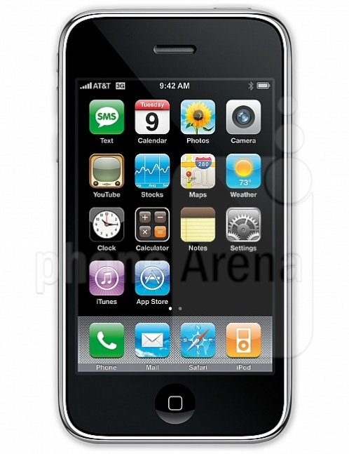
what is your number?
My phone number is 770-564-0257

Slide 6
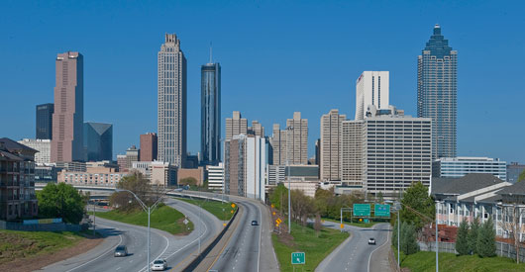
Where do you live?
I live in Georgia, Atlanta, United State Of America

Slide 7
What languages do you speak?
I speak Spanish and little English.

Slide 8
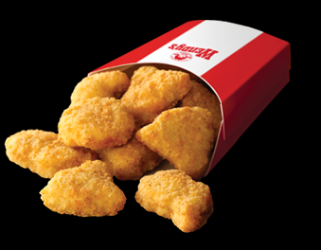
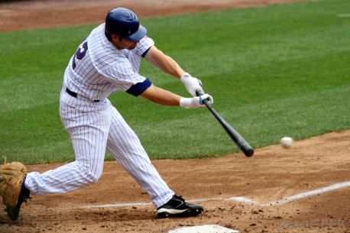
What do you like?
I like
Music: pop and rock
Food: Chinese food and chicken
sport: baseball
Dace and play guitar

Slide 9
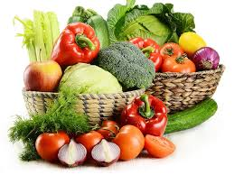
What do you dislike?
I dislike
Food: vegetables
Music: classical
Sport: basketball

