Slide 1
MY NAME IS KEVIN LOPEZ
all about me

Slide 2
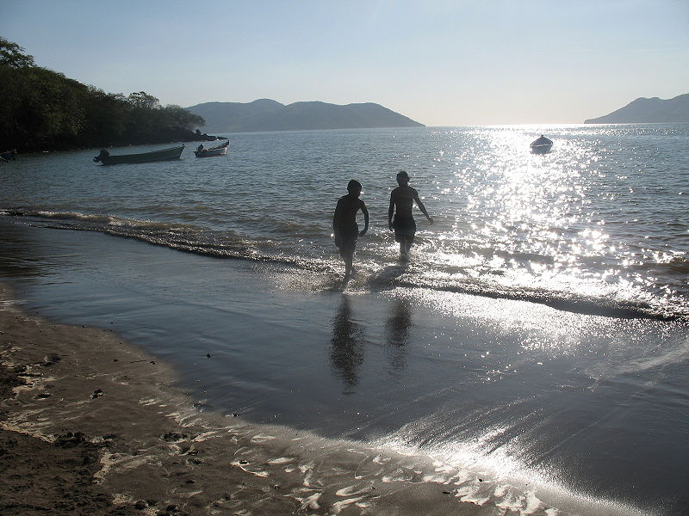
Where are you from?
I am from Honduras

Slide 3
HOW OLD ARE YOU?
I AM 16 YEAR OLD.
I WAS BORN MAY 20,1998

Slide 4
WHERE DO YOU LIVE?
I LIVE IN AUSTELL ATLANTA GEORGIA

Slide 5
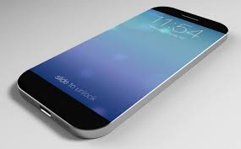
WHAT IS YOUR PHONE NUMBER
My phone number is 470 234 3777

Slide 6
What languages do you speak?
I am speak spanish

Slide 7
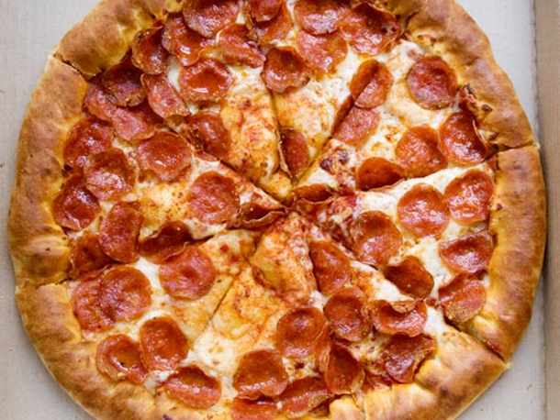
What do you like
I like

Slide 8
What do you dislike?
I dislike pasta
I dislike salad

