Slide 1
All about me
My name is german mejiia mendez

Slide 2
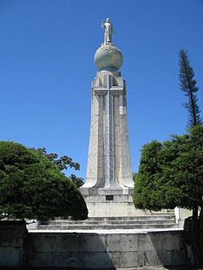
Where are you from?
I am from el salvador

Slide 3
How old are you?
I am 17 years old

Slide 4
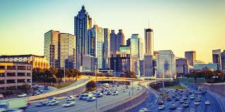
Where do you live?
Atlanta G.A

Slide 5
What is your phone number?
My phone number is 6784583679

Slide 6
What languages do you speak?
Chinesse
Spanish
English
Italian
Portugues
French

Slide 7
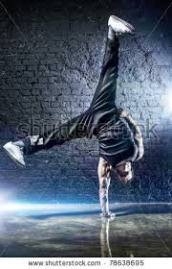
What do you like?
Breack dance

Slide 8
What do you dislike?
Vegetables
Garlic
Onions
end

