Slide 1
All about me
My name is : David Morales

Slide 2
Where are you from?
I am from El Salvador

Slide 3
How are you?
I am seventeen years old

Slide 4
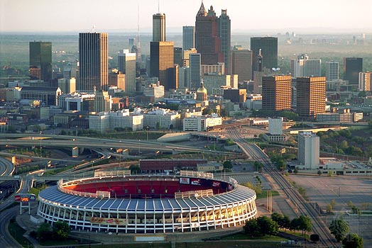
Where do you live?
I live in Atlanta Georgia U.S.A

Slide 5
What is your phone number?
My number phone is (404)546 420 4522

Slide 6
What languages do you speak?
I speak Spanish

Slide 7
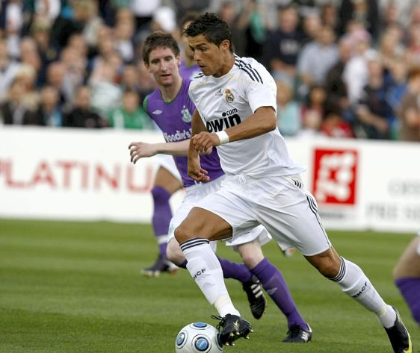
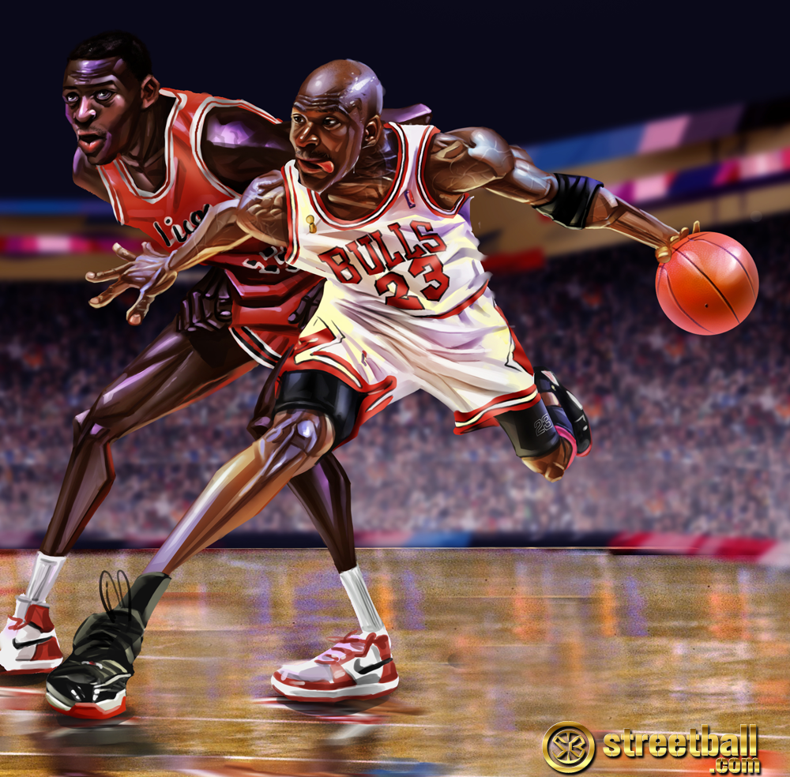
What do you like?
I my like the sport

Slide 8
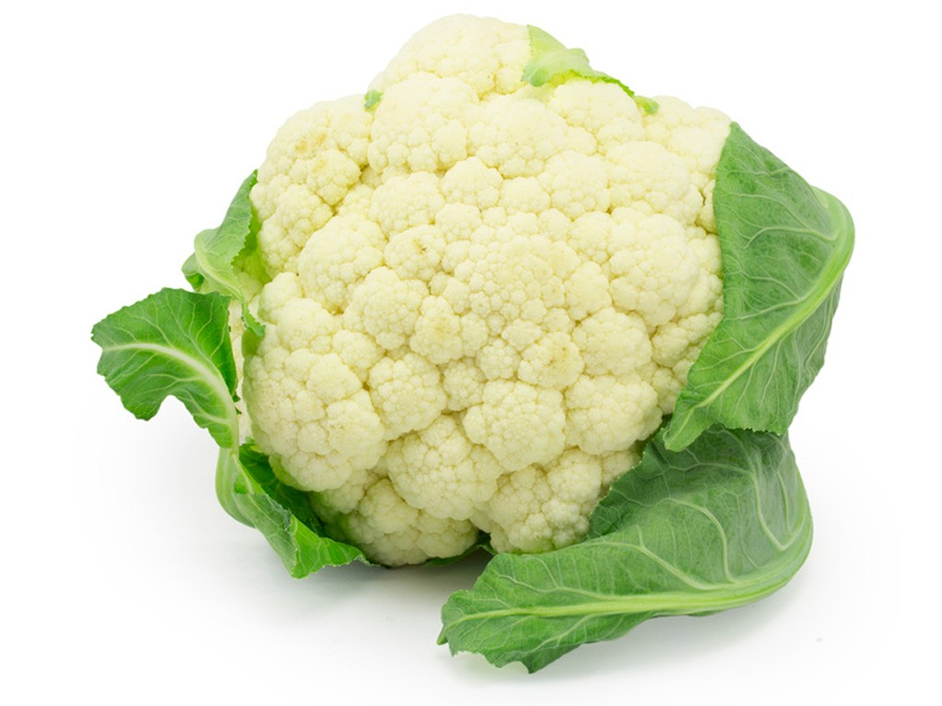
What do you dislike?
My don’t like

