Slide 1
ALL ABOUT ME
Claudia Cecibel Gamez Fuentes

Slide 2
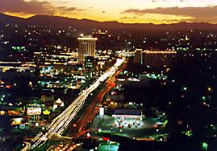
Where are you from?
I from El Salvador

Slide 3
How old are you?
15 years

Slide 4
Whatis your phone number?
My number is 4045125434

Slide 5
What lenguages do you speak?
I speak spanish

Slide 6
What do you like?
I like singler

Slide 7
What do you dislike?
I dislike animals

