Slide 1
All about me
by : Carlos rivas

Slide 2
Where are you from
I am from
HONDURAS

Slide 3
How old are you
I am 16 years

Slide 4
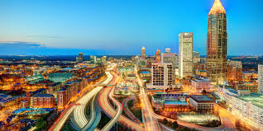
Where DO YOU LIVE?
I AM LIVE
ATLANTA G.

Slide 5
What is you phone number
my phone
number is
6788309904

Slide 6
What languages do you speak
English
and
spanish

Slide 7
What do you like
TBH?
I like to play soccer , &
I like moment with my family,
My favorite team fc barcelona
And I like the girl , I am single girl ,… lmfo

Slide 8
WHAT DO YOU DISLIKE
I DON’T LIKE THE TEAM REAL MADRID
SPEAK ENGLIHS

Slide 9
CARLOS RIVAS LOVE YOU OK: DONT WORRRY

